Slide 1


Societal Influences on Chemical Innovation
John F. Malloy

Slide 2
Motivation
How do societal constraints on chemistry (technology, money, etc…) manifest in the evolution of chemistry?
Studied through network science & molecular assembly

Slide 3
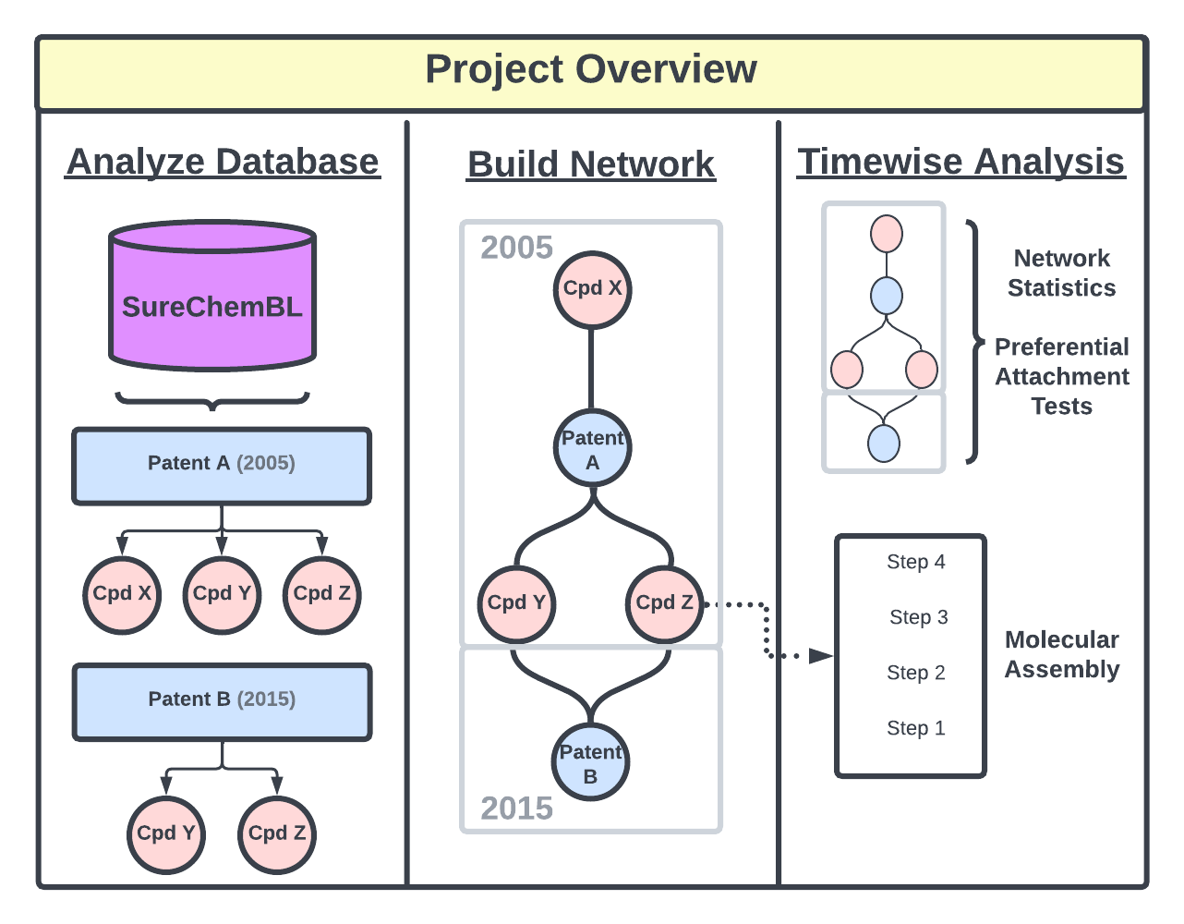
Notes:
Database structure -> Patents (with dates) contain compounds, which can be used across different patents

Slide 4
Notes:
The patent network is built by connecting patents with the compounds which are used within them. This is a dynamic process, with different parts of the network added based on the time the patent was registered.

Slide 5
Notes:
Network statistics are done on the dynamically generated network, testing preferential attachment along the way. Additionally, molecular assembly analyses are done on the compounds to track MA statistics over time.

Slide 6

Project Overview - SureChemBL
14 million patent documents
From USA, Europe & Japan
17 million unique compounds
Chemical patent data from 1968
Image extraction from 2008

Slide 7
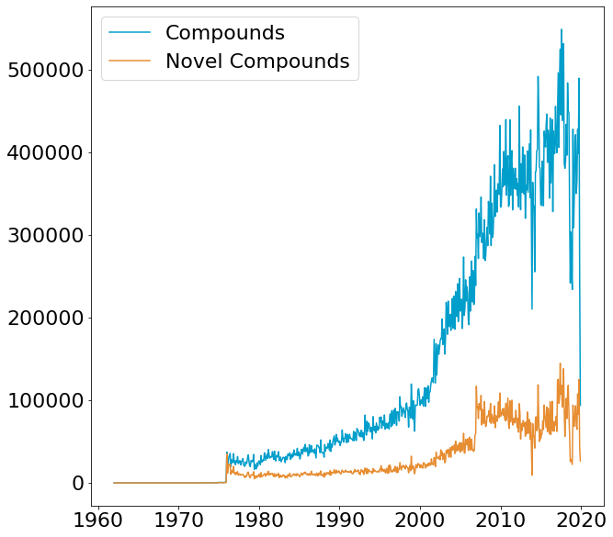
Using data from 1980 - present day
x-axis: month
Y-axis: compounds
“Novel” - new to database

Slide 8
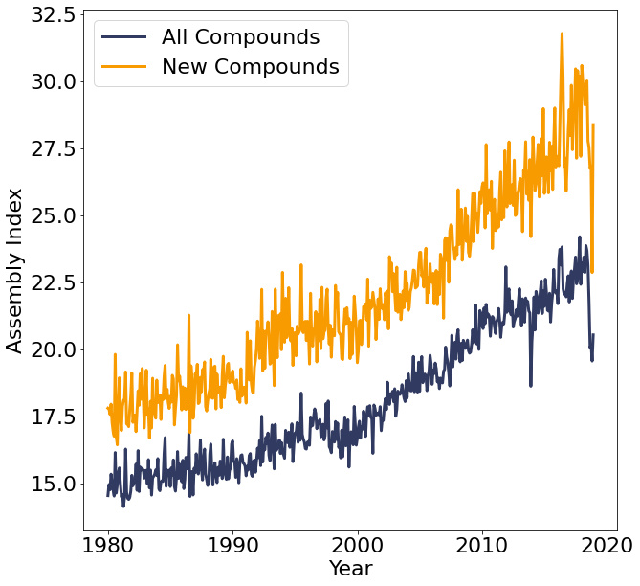
MA
Randomly selected 1000 compounds per month
From new compounds & full database

Slide 9
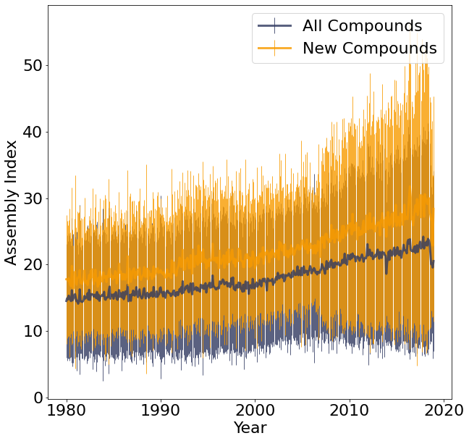
MA
Randomly selected 1000 compounds per month
From new compounds & full database
Error bars +/- 2 standard deviations

Slide 10
Expected MA
Is the observed MA different than what we would expect, given the molecular weights of each compound?
Sampled MA & molecular weight from:
MetaCyc
Massbank of North America
SureChemBL
GDB17
PubChem
Random chemical structures
Total = 1,008,371 compounds

Slide 11
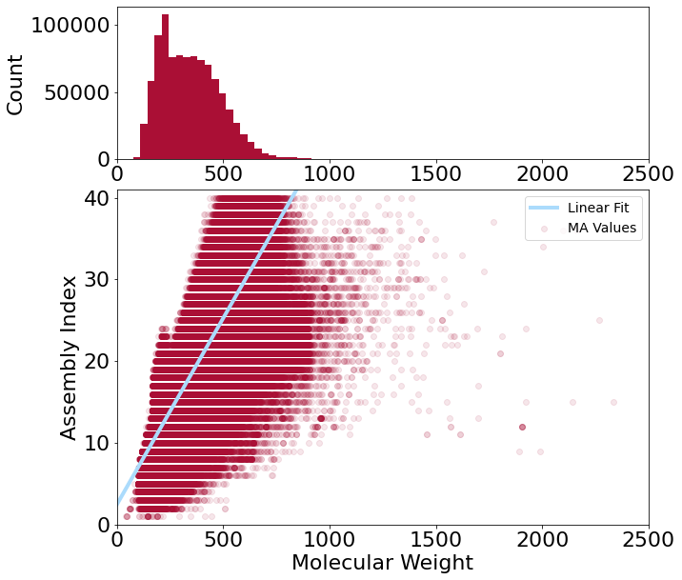
Expected MA
Fit a linear regression:
r² = 0.703

Slide 12
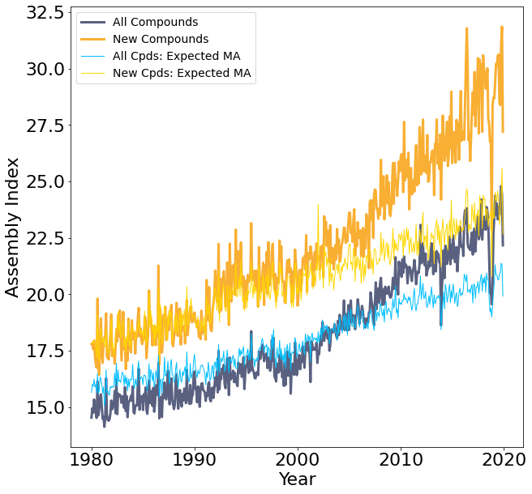
Expected MA
Calculated “expected MA” by:
Finding average molecular weight of samples
Using linear regression (previous slide) to predict expected MA

Slide 13
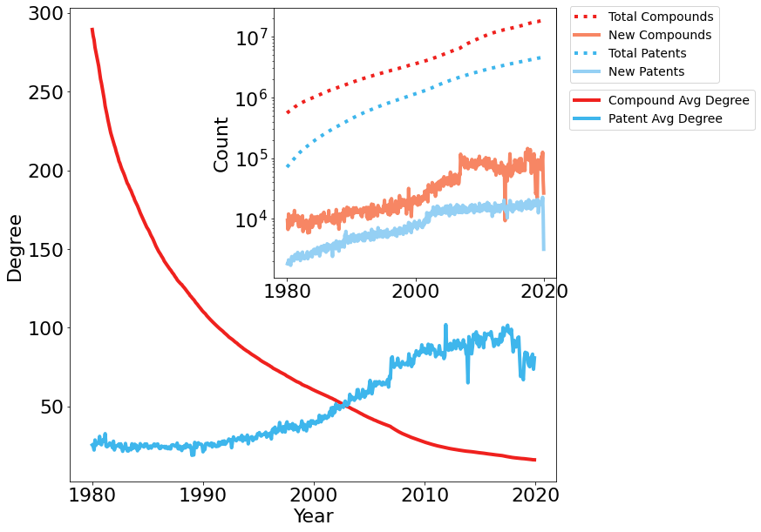
Network Statistics
Cpd Avg Degree
How many patents use a given compound
Patent Avg Degree
How many compounds are used within a given patent

Slide 14
Preferential Attachment
How are new compounds linked to existing chemistry?
Hypothesis:
Popular existing compounds are used to create new compounds

Slide 15
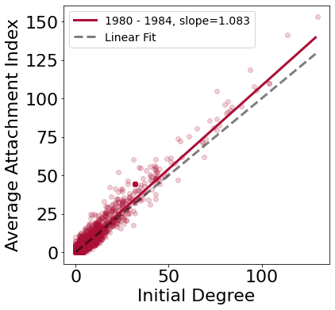
Preferential Attachment
Calculate initial compound degree
Calculate attachment index:
Average change in degree over a time period (60 months)
If there is a linear or superlinear relationship, this is evidence of preferential attachment

Slide 16
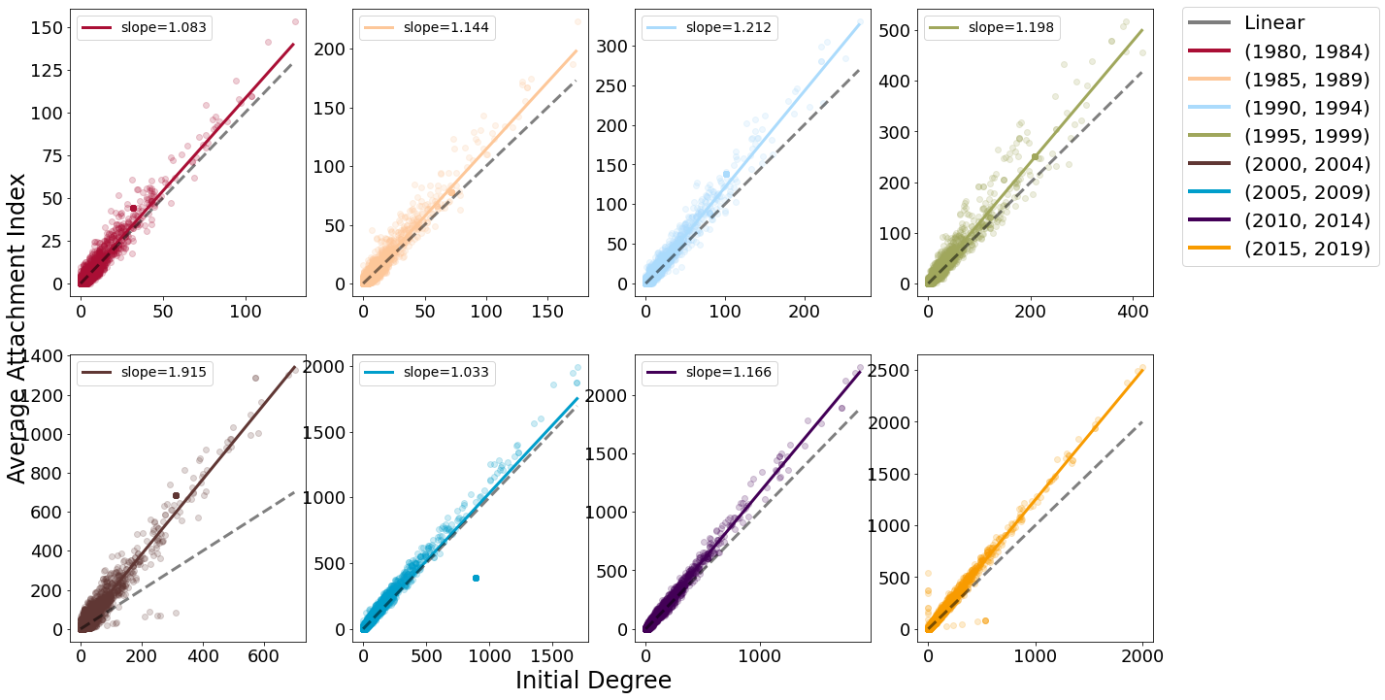
Notes:
Linear or superlinear trends are found in every 5-year sample of SureChemBL!
Slope for 2015-2019 is 1.247

Slide 17
Preferential Attachment
Result: The SureChemBL patent database is built using preferential attachment across 5-year time frames

Slide 18
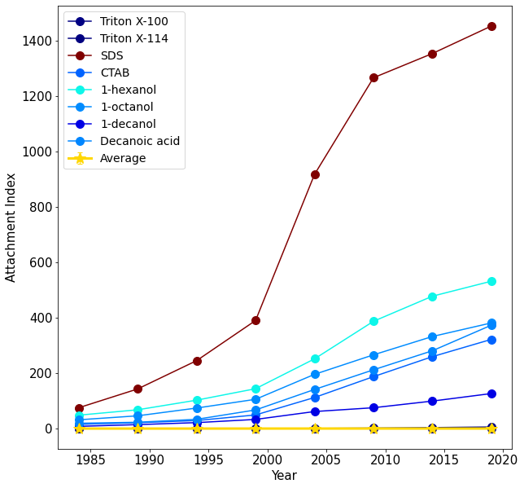
Preferential Attachment
Can track increasing/decreasing attachment over time of specifc compounds, relative to average
Green solvents: very high attachment relative to average
Shows these compounds are used far more frequently than average

Slide 19
Manuscript
https://docs.google.com/document/d/1Aw8FuVPF-d36pLncZFswyJacGjDl1-tq/edit?usp=sharing&ouid=106479236201810273481&rtpof=true&sd=true

